Slide 1


CAPSTONE PROJECT
AI-Powered Resume & Cover Letter Builder App Presentation
Prepared by:
Name: Charles Daniel Apollo
College: Athena Global Education
Course: Data Science

Slide 2

Outline
Problem Statement
Proposed Solution
System Architecture
Algorithm & Methodology
Development Process
Deployment Strategy
Results & Analysis
Future Scope
Conclusion
References

Slide 3

1.Problem Statement
In today’s competitive job market, many qualified professionals struggle not because they lack skills, but because they lack well-structured, ATS-optimized resumes and compelling cover letters.
From my own professional journey and from observing others, I identified several recurring challenges:
Job seekers often do not k<number>now how to translate experience into impact-driven statements.
Manual resume writing is time-consuming and inconsistent
Many resumes fail ATS screening due to missing keywords
Professional resume services are expensive and inaccessible, especially in low-resource contexts
Generic templates lack personalization, relevance, and adaptability
The core problem:Talented people are being filtered out by systems, not because they are unqualified, but because their documents are.

Slide 4

2.Proposed Solution
To address this gap, I designed and built an AI-Powered Resume & Cover Letter Builder that:
Uses AI-assisted content generation to create professional summaries and cover letters
Allows full user control and editing, ensuring authenticity
Produces ATS-optimized documents
Exports clean, professional DOCX files
Works as a self-service, web-based application
Key Objectives:
Democratize access to high-quality career tools
Balance automation with human personalization
Provide a production-ready, scalable solution

Slide 5

3. System Architecture
The system is designed using a modular, scalable, and fault-tolerant architecture.
Architecture Layers:
Presentation Layer
  Streamlit UI
  Interactive forms and dashboards
Application Logic Layer
  Resume generation engine
  Cover letter generation engine
  ATS optimization checker
  Payment & access control logic
AI & NLP Layer
  Enhanced prompt-based generation
  Keyword extraction and matching
  Context-aware summarization

Slide 6
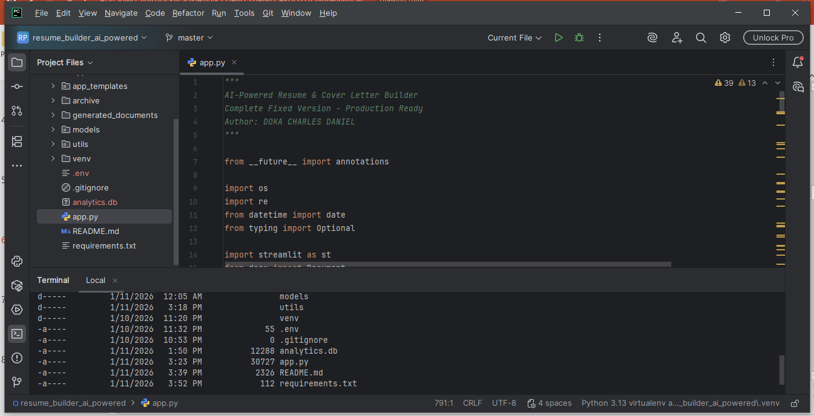

System Architecture cont…
Persistence & Analytics
  Event logging
  Usage analytics
  Admin dashboard
Output Layer
  DOCX document rendering
  Branding & formatting engine
This architecture ensures maintainability, extensibility, and production readiness.

Slide 7
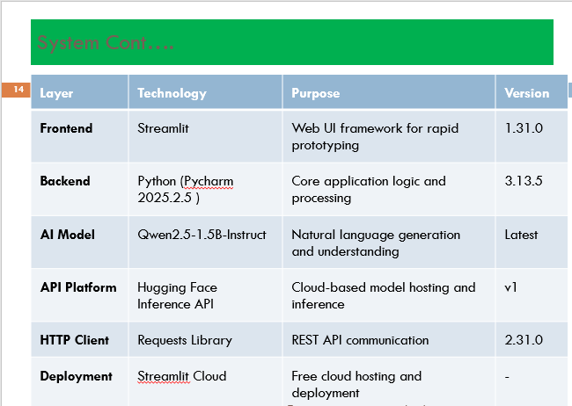

4. Algorithm & Methodology
Rather than blindly generating text, the system follows a structured AI-assisted methodology:
Resume Summary Generation
Inputs:
  Candidate profile (skills, experience, achievements)
  Optional job description
Method:
  Context enrichment
  Skill-experience alignment
  Achievement-focused phrasing
Output:
  Editable professional summary
  Source tracking (AI vs template)

Slide 8
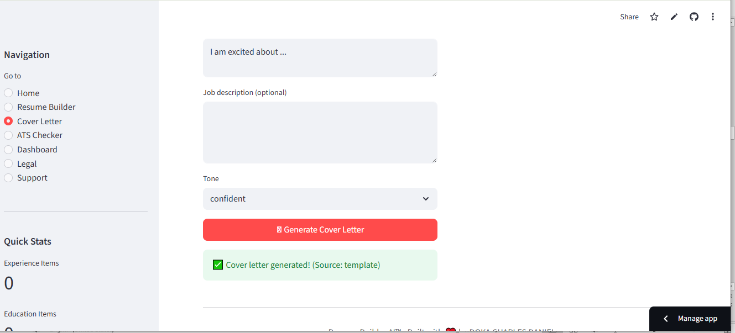
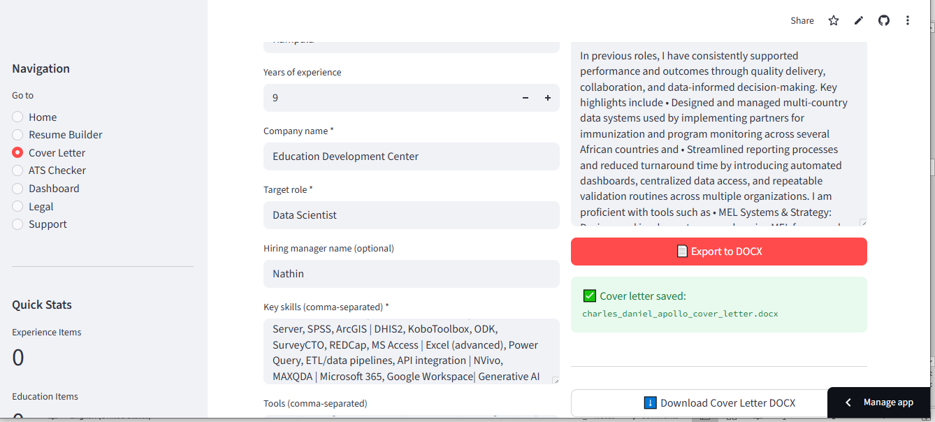

4. Algorithm & Methodology
Cover Letter Generation
Inputs:
  Role, company, motivation, achievements
  Optional hiring manager name
Method:
  Personalized narrative construction
  Tone control (professional, warm, confident)
Output:
  Structured, role-specific cover letter
ATS Optimization Algorithm
Tokenization and keyword extraction
Resume vs job description comparison
Scoring mechanism (0–100)
Matched and missing keyword suggestions
Key Principle:
AI assists — the human remains in control.

Slide 9
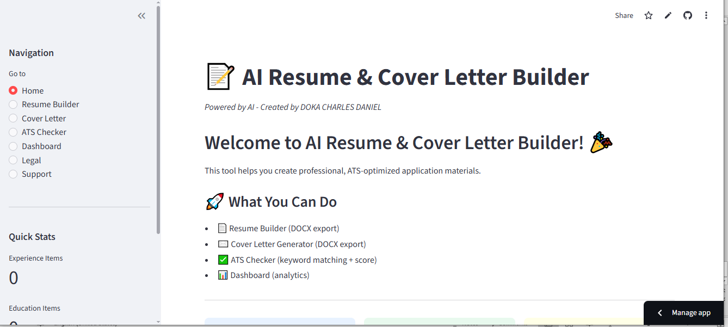

5.Development Process
I followed a pragmatic, iterative development approach:
Phase 1: Problem Analysis & Design
Defined user personas
Designed modular architecture
Planned extensibility and monetization
Phase 2: Core Feature Development
Resume builder module
Cover letter generator
DOCX rendering engine
ATS checker

Slide 10

Development Process cont…
Phase 3: UX & Reliability
Streamlit session state management
Fallback mechanisms for missing modules
Error handling and validation
Phase 4: Production Readiness
Payment gating
Admin dashboard
Analytics logging
Branding and legal considerations
Throughout development, I emphasized clean code, modularity, and real-world usability.

Slide 11

6. Deployment Strategy
The application is designed for cloud deployment, particularly on Streamlit Cloud, with:
Secure environment variables & secrets
Scalable front-end rendering
Lightweight backend logic
Easy CI/CD through GitHub
Key Deployment Features:
Feature-based paywall
Admin-only analytics access
Version-controlled updates
Minimal infrastructure overhead
This makes the solution easy to maintain and cost-effective to scale.

Slide 12
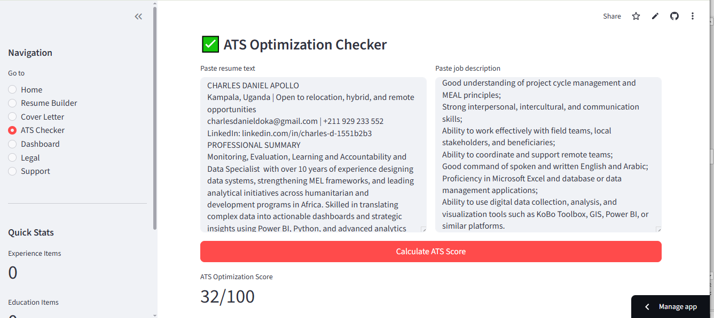

7. Results & Analysis
Achieved Outcomes:
Successfully generates:
  Professional resumes
  Tailored cover letters
  ATS optimization scores
Produces clean, branded DOCX documents
Logs user behavior for insights
Observed Benefits:
Significant reduction in resume creation time
Improved clarity and structure of documents
High flexibility across industries and roles

Slide 13

Results & Analysis cont…
Technical Strengths:
Modular design
Fallback-safe imports
Cached AI models for performance
Production-ready error handling

Slide 14

8. Future Scope
This project is intentionally designed for growth. Planned enhancements include:
Multi-language support
PDF export options
Resume version comparison
Job scraping and auto-matching
User accounts & document history
Advanced analytics & recommendation engine
Integration with LinkedIn and job portals
Long-term, this can evolve into a full AI career-development platform.

Slide 15

9. Conclusion
This AI-Powered Resume & Cover Letter Builder is more than a coding project—it is a solution born from real professional challenges.
It demonstrates:
Practical application of AI
Strong software engineering principles
User-centric design
Business and scalability thinking
My goal was not to replace human storytelling, but to empower it with intelligence.

Slide 16

References
Pyhton: https://www.python.org/downloads/
https://www.jetbrains.com/pycharm/
https://share.streamlit.io/
https://github.com/Charles-12345/resume_builder_ai_powered

Slide 17

Gitub Link
Gitub: https://github.com/Charles-12345/resume_builder_ai_powered.git
Deployment Link: https://dokacharlesdaniel-resume-builder.streamlit.app/

